Slide 1


Fundamentals of RM
RM System and Process
Leadership in RM
Incident Investigation
RM Tools & Challenges
RM in Industry
People & Org.
Application and Perspectives
On Becoming a
Leader in Risk Management
ENGG404 - Lecture
Chapter 6.2: Safety Metrics,
Lagging and Leading Indicators

Slide 2
Learning Outcomes:
Explain leading indicators and lagging indicators, and the difference between them.
Explain how applying leading indicators can:
Measure the overall effective implementation (execution) of a risk management program.
Identify deficiencies (degradation, deterioration) of critical safety conditions and critical safety rules for both occupational safety and technical safety.
Chapter 6.2: Safety Metrics, Lagging and Leading Indicators
2
Notes:
2

Slide 3
Examples: Leading and Lagging Indicators
Leading indicators are used to determine the effectiveness of certain elements in a risk management program, and where there is no consequence.
Lagging indicators are the results, the outcomes of potential weaknesses in certain elements in a risk management program, and usually where there is a consequence i.e. a loss.
Number of occupational injuries reportable to the gov’t per month LAG
Number of SC’s and SP’s reported per month LEAD
Number of data breaches per year LAG
Number of attempts to defeat the security firewall per day LEAD
Number of over-pressure vessel failures in the plant life LAG
Number of over-pressure relief valves overdue for service LEAD
Number of fasteners under-torqued on a bridge construction inspection LEAD
Number of steel members with loose fasteners LEAD
Number of steel members damaged under load LAG
Number of over-current breaker trips per month LEAD
Number of motor burn-outs per year LAG
Number of significant near-miss events where the consequences could have been catastrophic were it not for some “lucky” factor e.g. a person was almost struck by a falling structure and could have been killed. LAG or LEAD – depending on the reporting criteria of the organization; Generally, if no loss, it is tracked as a LEADING indicator because this metric is usually not reported up through the organization
Chapter 6.2: Safety Metrics, Lagging and Leading Indicators
3
Notes:
3

Slide 4
The Incident Pyramid, per Frank Bird:
The Incident Pyramid depicts the performance of the organization.
Bird, Frank E., and Loftus, Robert G., Loss Control Management,
International Loss Control Institute, 1976.
For our purposes, use the ratios (1 : 10 : 30 : 600 : 10,000) as shown above.
Chapter 7.4: Importance of Culture & Making Everyone a Leader in Safety
4
Notes:
4

Slide 5
Incidents with Consequence vs. Incidents with No Consequence:
Chapter 7.4: Importance of Culture & Making Everyone a Leader in Safety
5
Notes:
5

Slide 6
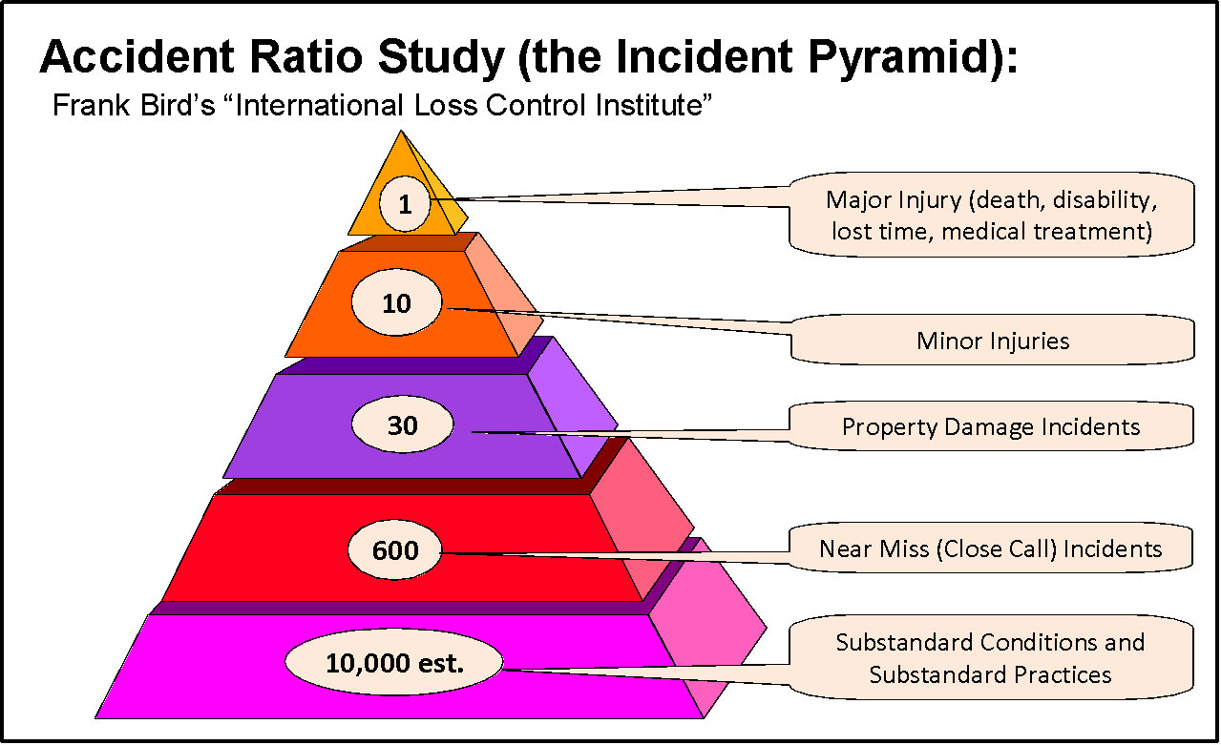
Lagging Indicators – General Examples:
Lagging indicators track incidents with consequences:
  Number of incidents with consequences reported
  Number of incident investigations on incidents with consequences performed
  Number of first aid cases
  Number of serious injuries
  Number of fatalities
In other words, something bad happened to create the data point!
Metrics derived from The Incident
Pyramid
WITH
Chapter 6.2: Safety Metrics, Lagging and Leading Indicators
6
Notes:
6

Slide 7
Lagging Indicators – Specific Definitions:
Fatal Accident Rate (FAR) – UK
  Fatality: a worker was killed on-the-job or due to a chronic work-related illness e.g. cancer, asbestosis, silicosis.
Lost Time Incident Rate (LTIR) – USA
  Lost time incidents: Injury incidents where medical treatment is given and results in days-away-from-work for the injured employee.
Total Recordable Incident Rate (TRIR) – USA
  Recordable incidents: fatalities; hospitalizations; injuries and illnesses that lead to medical treatment beyond first aid aka days-away-from-work cases, restricted-work cases, or job-transfer-due-to-injury cases
  TRIR includes LTIR
  (see Topic #9 Chapter 2.1:Why is Risk Management Important? for an example on how to calculate an IR)
  For purposes of this course, LTIR and TRIR are the same, and can be referred to as “Injury Frequency Rate” (IFR). Recall:
  IFR = (number of injuries x 200,000 hours) / (Total exposure hours)
  There is no national roll-up statistic for Canada – each province tracks, usually as “Lost Time injury (or Incident) Rate” per provincial Workers’ Compensation Boards.
Chapter 6.2: Safety Metrics, Lagging and Leading Indicators
7
Notes:
Multiplying: Used to compare companies of various sizes together over a period of time. Explained in more detail on the next slide. The ideal value for all 3 lagging indicators is 0. A good TRIR score is < 3
200,000 = 100 employees * 40 hours/week * 50 weeks/year

Slide 8
Lagging Indicators – Challenges and Limitations:
Challenges and limitations with using lagging indicators include:
Tends to be an over-emphasis on occupational injuries.
Technical safety is overlooked.
Not all incidents are reported or investigated.
Negative trends can create “knee-jerk” reactions.
Positive trends are not appropriately resourced.
Cannot be used as a means to influence safety culture.
Especially for technical safety incidents, there may be long durations of “positive” performance between events
  “Lull” the organization into a false sense of “security”
  Recall, technical safety incidents are extremely low likelihood with extremely high (catastrophic) consequences.
Chapter 6.2: Safety Metrics, Lagging and Leading Indicators
8
Notes:
8

Slide 9
Leading Indicators – Examples:
In contrast, the leading indicators are created as a result of a proactive planned inspection or audit that is intended to assess the effective implementation of the RM program. These audits can be tracked on a “rate” basis e.g. # per week, # per hours of operation, etc.
    # of administrative controls reviewed and updated
    # of inspections on safety equipment carried out, RME #8 O&M
    # of employees with up-to-date qualifications, RME #9 EC&T
    # of management safety audits completed, RME #6 PECI
    # of changes appropriately managed, RME #4 MOC
    # of job observations and planned inspections carried out
    # of safety systems disabled or bypassed
    # near miss incident reports received and reviewed
    # near miss incident reports addressed
    # of SC and SP reports received and reviewed
    # of SC and SP reports addressed
    # safe behavior awards presented to employees
In other words, look for signals (the data points) before something bad happens!
Chapter 6.2: Safety Metrics, Lagging and Leading Indicators
9
Notes:
A more proactive approach is the use of leading indicators, which are measures or activities taken to prevent incidents from occurring. If used correctly, leading indicators focus resources on incident prevention, as well as allow management to actively demonstrate leadership and empower workers to engage in discussions about how to prevent future incidents. Leading indicators must be measurable, positive, simple, and result in incident prevention. In other words, personnel resources and time focused on tracking leading indicators should result in a positive focus on safety and incident prevention (i.e. what you want to achieve, not the negative results). The choice of leading indicators are specific to the organization and its activities, but some common ones consist of the following:

Slide 10
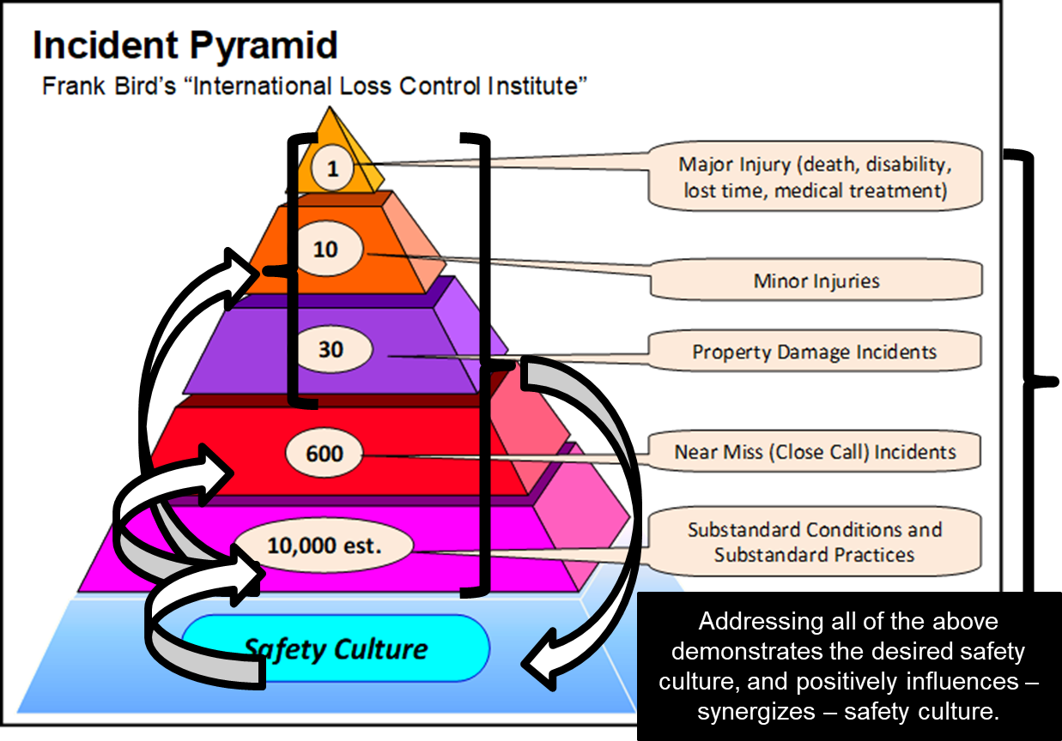
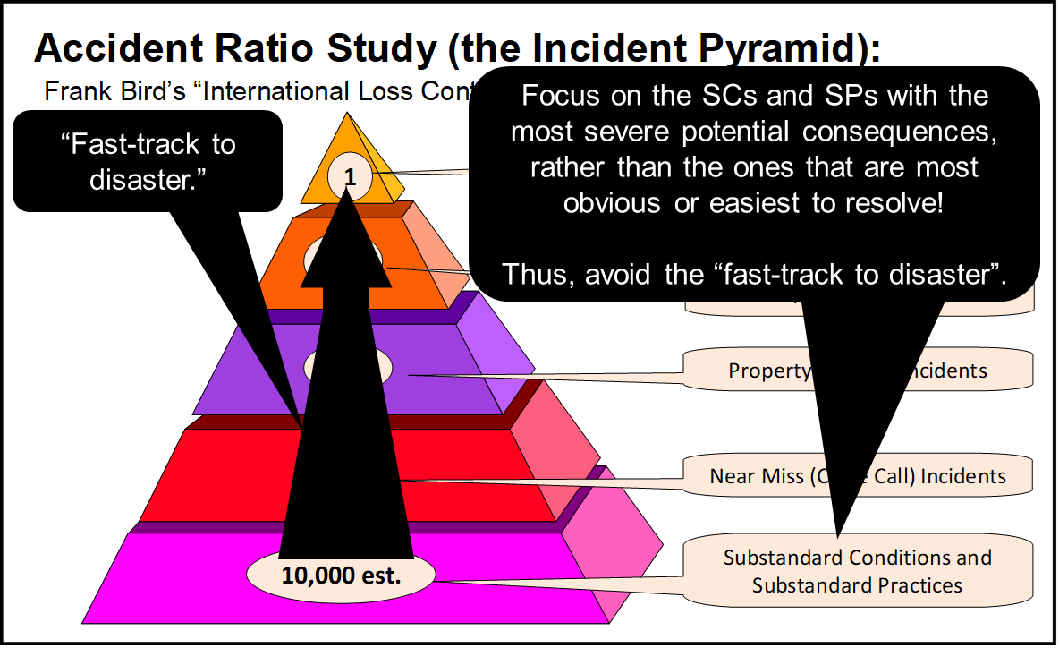
Leading Indicators – Benefits:
Can be directly used by leaders to influence
the safety culture of the organization!
Implementation of the RM program is
measured on an on-going basis using
leading indicators, and proactive action
can be taken to address deficiencies
before a loss incident occurs.
“Early signals” for critical sub-standard
conditions and sub-standard practices,
when the risk level increases substantially,
can be used to inform leaders in the allocation of resources to address these; thus avoiding situations where “one small misstep” can lead to a catastrophic event i.e. the “fast track to disaster”.
Chapter 6.2: Safety Metrics, Lagging and Leading Indicators
10
Notes:
10

Slide 11
Examples: Allocate Resources Based on Indicators
You are the most senior engineer (in terms of technical expertise) in your company and have a thorough and detailed knowledge of the technology applied in your company’s projects. You receive weekly reports on leading indicators for the numerous bridge construction and bridge rehabilitation projects for which you have technical oversight across the company. You decide to allocate resources to address the issues in this order:
Fraction of fasteners inspected and found under-torqued on new or rehab bridge construction (consequence: imminent structural collapse)
Fraction of metal surface areas with defective protective coating (consequence: extensive future repairs or delayed structural collapse)
Number of SP’s reported that solely pertain to lack of PPE (consequence: limited to injury to the one individual)
Number of times that flagging personnel unnecessarily delayed local traffic (consequence: none on PEAP)
Chapter 6.2: Safety Metrics, Lagging and Leading Indicators
11
Notes:
11

Slide 12
Summary and Key Lessons:
Summary:
Lagging indicators are “after the fact” of a loss incident.
Superior organizations use leading indicators to
measure the effectiveness of a RM program i.e. look at the effective and compliant work execution of administrative controls and effectiveness of engineered systems.
improve safety culture,
promote communication,
prevent incidents,
ultimately improve safety performance.
Metrics are based on “counts”, and a meaningful “rate” can be determined, standardized, applied, monitored, and tracked.
Key Lessons
Leaders can use leading indicators to:
Measure the overall effective implementation (execution) of a risk management program.
Identify deficiencies (degradation, deterioration) of critical safety conditions and critical safety rules for both occupational safety and technical safety.
Chapter 6.2: Safety Metrics, Lagging and Leading Indicators
12
Notes:
12

Slide 13
Complete Slide Deck follows with details.
13
Notes:
13

Slide 14
Learning Outcomes:
Explain the difference between leading indicators and lagging indicators.
Explain how applying leading indicators can:
Measure the overall effective implementation of a risk management program.
Identify deficiencies (degradation, deterioration) of critical safety conditions and critical safety rules for both occupational safety and technical safety.
Chapter 6.2: Safety Metrics, Lagging and Leading Indicators
14
Notes:
14

Slide 15
Examples: Leading and Lagging Indicators
Leading indicators are used to determine the effectiveness of certain elements in a risk management program, and where there is no consequence.
Lagging indicators are the results, the outcomes of potential weaknesses in certain elements in a risk management program, and usually where there is a consequence i.e. a loss.
Number of occupational injuries reportable to the gov’t per month LAG
Number of SC’s and SP’s reported per month LEAD
Number of data breaches per year LAG
Number of attempts to defeat the security firewall per day LEAD
Number of over-pressure vessel failures in the plant life LAG
Number of over-pressure relief valves overdue for service LEAD
Number of fasteners under-torqued on a bridge construction inspection LEAD
Number of steel members with loose fasteners LEAD
Number of steel members damaged under load LAG
Number of over-current breaker trips per month LEAD
Number of motor burn-outs per year LAG
Number of significant near-miss events where the consequences could have been catastrophic were it not for some “lucky” factor e.g. a person was almost struck by a falling structure and could have been killed. LAG or LEAD – depending on the reporting criteria of the organization; Generally, if no loss, it is tracked as a LEADING indicator because this metric is usually not reported up through the organization
Chapter 6.2: Safety Metrics, Lagging and Leading Indicators
15
Notes:
15

Slide 16
Lagging Indicators – General Examples:
Lagging indicators track incidents with consequences:
  Number of incidents with consequences reported
  Number of incident investigations on incidents with consequences performed
  Number of first aid cases
  Number of serious injuries
  Number of fatalities
In other words, something bad happened to create the data point!
Metrics derived from The Incident
Pyramid
WITH
Chapter 6.2: Safety Metrics, Lagging and Leading Indicators
16
Notes:
16

Slide 17
Lagging Indicators – Specific Definitions:
Many different metrics:
Three specific metrics, all of which are lagging indicators, use recordable injuries to quantify a company’s safety performance:
Fatal Accident Rate (FAR) – UK
  Fatality: a worker was killed on-the-job or due to a chronic work-related illness e.g. cancer, asbestosis, silicosis.
  Estimated number of fatalities per 1000 employee-working-lifetimes for an activity (~100,000,000 working hours)
Total Recordable Incident Rate (TRIR) – USA
  Recordable incidents: fatalities; hospitalizations; injuries and illnesses that lead to medical treatment beyond first aid; aka days-away-from-work cases, restricted-work cases, or job-transfer-due-to-injury cases
  Measured per 100 workers in a 1-year period
Lost Time Incident Rate (LTIR) – USA
  Lost time incidents: Injury incidents where medical treatment is given and results in time-away-from-work for the injured employee.
  Measured per 100 workers in a 1-year period
  There is no national roll-up statistic for Canada – each province tracks, usually as “Lost Time injury (or Incident) Rate” per provincial Workers’ Compensation Boards.
  Note: For purposes of this course, LTIR and TRIR are the same.
Chapter 6.2: Safety Metrics, Lagging and Leading Indicators
17
Notes:
Multiplying: Used to compare companies of various sizes together over a period of time. Explained in more detail on the next slide.
The ideal value for all 3 lagging indicators is 0.
A good TRIR score is < 3

Slide 18
Lagging Indicators – Specific Definitions:
Incidents used:
  FAR only uses fatalities (F’s)
  TRIR includes F’s, LTI’s, and injuries requiring more than first aid
  LTIR does not include Fatalities, only Lost Time Incidents
  Note: For purposes of this course, LTIR and TRIR are the same.
Calculations for the Rates:
  FAR is expressed as the number of fatalities per 1000 employee- working lifetimes:
    FAR = (# of fatalities * 100,000,000) / (# of hours worked)
    100,000,000 = 1000 employees* 50 years* 50 weeks/year* 40 hours/week
  TRIR and LTIR are rates per 100 worker-hours in 1 year (200,000 hours)
    TRIR = (# of recordable incidents* 200,000) / (# of hours worked)
    LTIR = (# of lost time incidents * 200,000) / (# hours worked)
    200,000 = 100 employees * 40 hours/week * 50 weeks/year
Chapter 6.2: Safety Metrics, Lagging and Leading Indicators
18
Notes:
Calculation uses full time workers only.
40 hours per week, 50 weeks/year is 2000 hours per worker - it is assumed each employee has 2 weeks of vacation.

Slide 19
Lagging Indicators – Challenges and Limitations:
Challenges and limitations with using lagging indicators include:
Even though lagging indicators include both occupational and technical safety, there tends to be an over-emphasis on occupational injuries.
Not all are reported or investigated.
Negative trends can create “knee-jerk” reactions.
Positive trends are not appropriately resourced.
  A short-term positive trend could be mis-managed as “We have solved the problem. The issues are behind us.”
Cannot be used as a means to influence safety culture for effective and sustainable performance improvements.
Especially for technical safety incidents, there may be long durations of “positive” performance between events
  This can “lull” the organization into a false sense of “security” and the RM program is “invulnerable” or at least “robust”.
  Recall, technical safety incidents are extremely low likelihood with extremely high (catastrophic) consequences.
Chapter 6.2: Safety Metrics, Lagging and Leading Indicators
19
Notes:
19

Slide 20
Leading Indicators – Examples:
In contrast, the leading indicators are created as a result of a proactive planned inspection or audit that is intended to assess the effective implementation of the RM program. These audits can be tracked on a “rate” basis e.g. # per week, # per hours of operation, etc.
    # of administrative controls reviewed and updated
    # of inspections on safety equipment carried out, RME #8 O&M
    # of employees with up-to-date qualifications, RME #9 EC&T
    # of management safety audits completed, RME #6 PECI
    # of changes appropriately managed, RME #4 MOC
    # of job observations and planned inspections carried out
    # of safety systems disabled or bypassed
    # near miss incident reports received and reviewed
    # near miss incident reports addressed
    # of SC and SP reports received and reviewed
    # of SC and SP reports addressed
    # safe behavior awards presented to employees
In other words, look for signals (the data points) before something bad happens!
Chapter 6.2: Safety Metrics, Lagging and Leading Indicators
20
Notes:
A more proactive approach is the use of leading indicators, which are measures or activities taken to prevent incidents from occurring. If used correctly, leading indicators focus resources on incident prevention, as well as allow management to actively demonstrate leadership and empower workers to engage in discussions about how to prevent future incidents. Leading indicators must be measurable, positive, simple, and result in incident prevention. In other words, personnel resources and time focused on tracking leading indicators should result in a positive focus on safety and incident prevention (i.e. what you want to achieve, not the negative results). The choice of leading indicators are specific to the organization and its activities, but some common ones consist of the following:

Slide 21
Leading Indicators – Benefits:
Can be directly used by leaders to influence the safety culture!
This concept is further explored in Chapter 7.
Chapter 6.2: Safety Metrics, Lagging and Leading Indicators
21
Notes:
21

Slide 22
Leading Indicators – Benefits:
For technical safety incidents, the implementation of the RM program is measured on an on-going basis using leading indicators, and proactive action can be taken to address deficiencies before a loss incident occurs.
“Early signals” for critical sub-standard conditions and sub-standard practices, when the risk level increases substantially, can be used to inform leaders in the allocation of resources to address these; thus avoiding situations where “one small misstep” can lead to a catastrophic event i.e. the “fast track to disaster”.
Chapter 6.2: Safety Metrics, Lagging and Leading Indicators
22
Notes:
22

Slide 23
Summary and Key Lessons:
Summary:
Lagging indicators are “after the fact” of a loss incident.
Superior organizations use leading indicators to
measure the effectiveness of a RM program i.e. look at the effective and compliant work execution of administrative controls and effectiveness of engineered systems.
improve safety culture,
promote communication,
prevent incidents,
ultimately improve safety performance.
Metrics are based on “counts”, and a meaningful “rate” can be determined, standardized, applied, monitored, and tracked.
Key Lessons
Leaders can use leading indicators to:
Measure the overall effective implementation (execution) of a risk management program.
Identify deficiencies (degradation, deterioration) of critical safety conditions and critical safety rules for both occupational safety and technical safety.
Chapter 6.2: Safety Metrics, Lagging and Leading Indicators
23
Notes:
23

